Slide 1




An Innovative Project done in partial fulfilment of the requirement for the award of the degree of
Bachelor of Technology in CSE

Slide 2

This project has been made & submitted by :
Adrija Nag
Anubhab Pal
Anwesa Sinha
Arijit Dey
Asmita Sarkhel
Draksha
Pramit Roy
Samriddhi Dubey
Satyaki Dawn
Subhadip Das
Enrollment No. 12021002001163
Enrollment No. 12021002001190
Enrollment No. 12021002001154
Enrollment No. 12021002001177
Enrollment No. 12021002001166
Enrollment No. 12021002001182
Enrollment No. 12021002001252
Enrollment No. 12021002001175
Enrollment No. 12021002001155
Enrollment No. 12021002001258

Slide 3

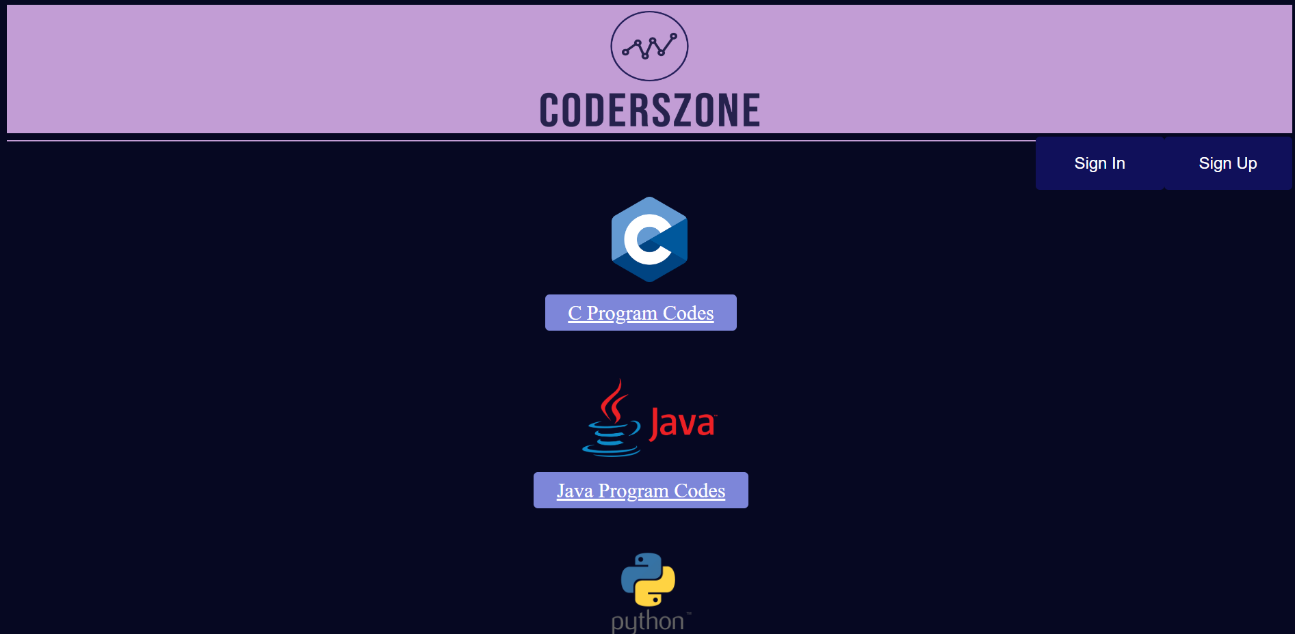
INTRODUCTION :
Technology has played an important role in improving and expanding education worldwide. Websites are a part of technology through which institutions and companies can easily and cheaply share and advertise their profiles with the rest of the world.
This website has been developed by the students of UEM Kolkata to help in a beneficial way to get access to educational codes, user friendly
interface, easy navigation, in order to get
their ideas about the role and importance
of a website for self improvement
and studies for further accomplishments.

Slide 4

LITERATURE SURVEY :
A literature survey is a piece of academic writing demonstrating knowledge and understanding on a specific topic placed in context.
We have also included a critical evaluation of our website and reviewed the whole process. It is used for educational purposes and has different features that aid learning. This is a website that is used for designing effective programming language courses such as C, Python and Java.
Features of the website that makes it suitable to be used include:
1. Usefulness:
This website is divided into two frames. The page is simple and contains information that can be easily accessed. The users can easily navigate from one part of the website to another since the links are all included on the home page. As the learning process progresses, the level advances. It gives the users an opportunity to learn from the simplest features to the more complicated ones step by step.
2. Ease of use:
The website is very easy to use. When a link is clicked on the left frame, it opens up on the right. The left frame remains visible at all times. This makes it easy for the users to cascade from one page to the other of the website without difficulty.

Slide 5
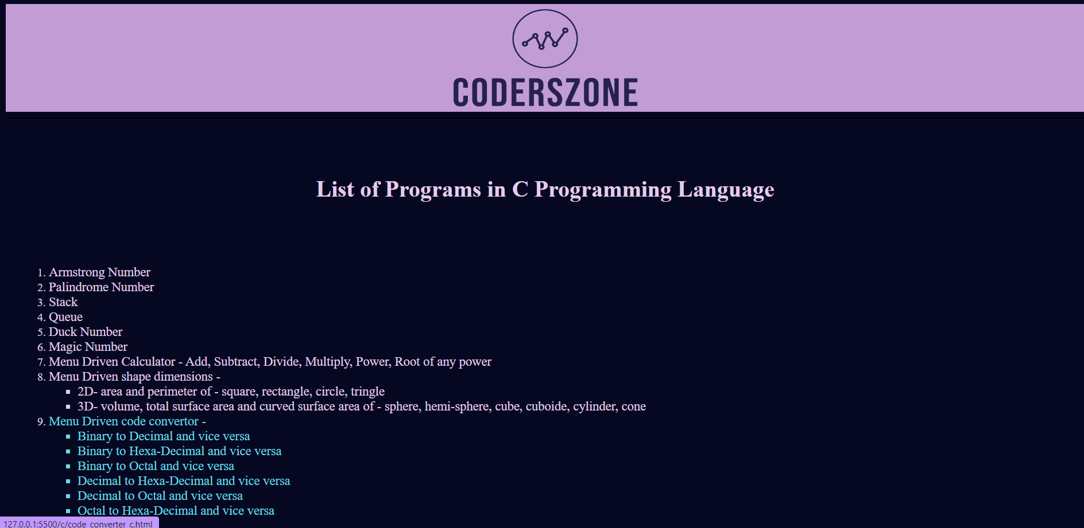
3. Cost:​
This website makes the learning process very easy since most of the resources that are required for the course are easily available. The website is also simple which makes the design work and the maintenance work very easy.​
4. Reliability:​
This website is very reliable and legitimate as the information in the website is constantly updated so as to meet the constant change/advancement
in technology.​
5. Teaching or learning outcomes:​
Lessons taught and codes provided
using this website are easy to understand
and follow. The systematic way that is
arranged makes it very easy for the users to
understand.​

Slide 6
PROBLEM STATEMENT :
There have been several problems with transitioning to a fully online based educational website. port aims to describe the advantages and disadvantages of this transition, with interviews and case studies.
Internet Reliance:
That one flaw with the internet is that it is not everywhere yet. If your internet goes down or you happen to be in an area that has not been connected yet you will not be able to access this web page.
Security:
There is no denying that data provided by the user is less secure when it is in the cloud, especially when users from all over the world are accessing the same server hosted by a third party. Although there are ways to reduce your risk, email encryption and SSL enforcement for secure HTTPS access are just two examples.

Slide 7
Reduced Speed:
A web page will probably be slower. The user needs to decide if a slight reduction in speed is worth the worldwide access.
Browser Support:
Unfortunately, users do not have access to one version of a browser because of given choices. This means it has to make sure the web page is supported across various browsers and for various screen sizes.

Slide 8

PROPOSED SOLUTION :
This website which has been reviewed above contains educational information which can be used in a systematic way. It has procedures that can be used for studying different articles in different subparts that anyone can cover. There are some websites which can be used for online learning by students in different parts of the world. Unlike the use of traditional learning methods, the use of the website increases flexibility in the learning process. Also, students do not need to travel to the classroom so as to learn since all the information needed can be easily obtained from the internet.
This option also gives the users an opportunity to do other jobs and perform the learning process at their own time. The use of these types of
learning resources also makes the process
of gaining knowledge much easier and
cheaper as compared to traditional
teaching methods.

Slide 9

EXPERIMENTAL SETUP AND RESULT ANALYSIS :
We have examined several descriptive statistics out of a mass of raw submissions and given suggestions. Their value lies primarily in the light that they may shed on characteristics. We also took a conceptual tour of decision-making.
Eventually, it will be easier to understand how the users are learning and getting benefited, and how they have performed in each area of their requirements. It will also be helpful to provide management information as well as to identify areas of strength and weakness of the users.
We have initiated a few suitable solutions to improve the website, which are listed below:
1. The users will be able to access the website and create a personalized account to code and for further accumulation of data and statistics. After registering, they have an account with
the providers of the website. Once a user registers, they are given the required
login details. The user can then use the details to login into the system and access
the learning resources which are available on the website.

Slide 10
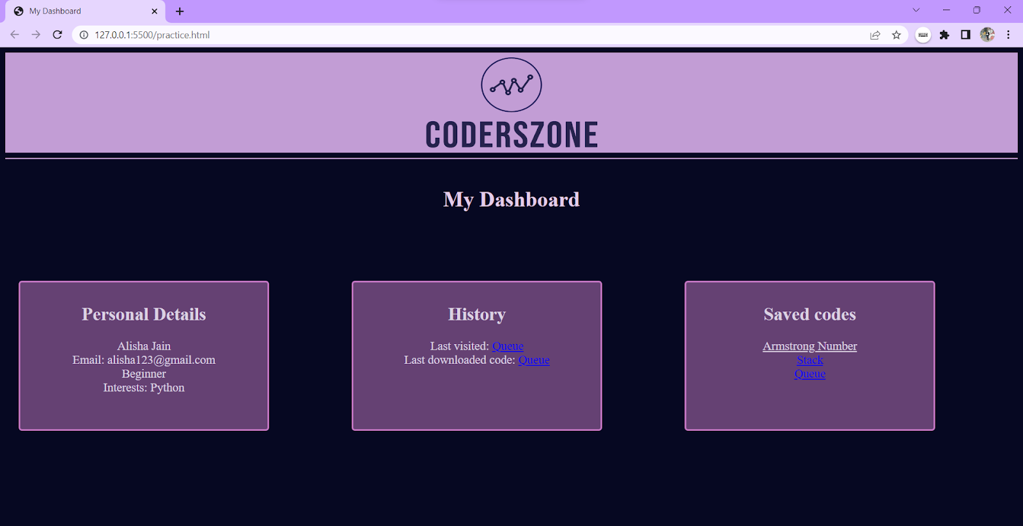
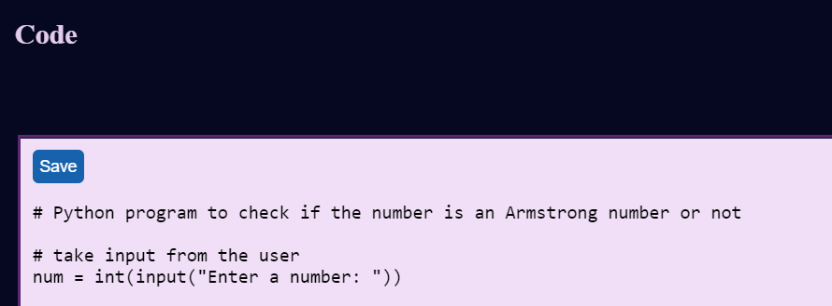
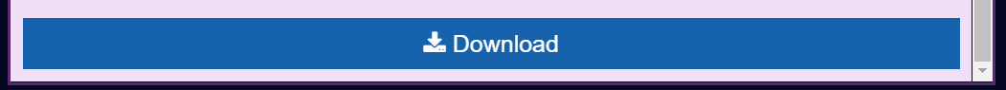
2. A dashboard will be created and provided to each user after they log in through and start compiling. When planning for the lessons, users should be categorized into different groups depending on their learning capabilities . More training time should be allocated to users who are less sharp so that they grasp what is being taught and what the learning resources are all about.
3. The users can search and load programs, as well as
verify, execute and recompile them according to one’s certain
needs.
4. The use of this technology is very effective as it contains a lot of
information that can be used in the learning process. The users will be
able to access all the information and this makes the use of these resources
a very good method for imparting knowledge. For further research
and analytics, the users can download the codes and save them in respective extensions.

Slide 11

CONCLUSION & FUTURE SCOPE :
Our website also has the very helpful feature of saving and downloading a particular code for the user’s future reference. The saved codes are then shown on the profile dashboard of the user. Our download feature lets you download the code in the specific language’s extension (i.e. .c for C program files, .java for Java files, and .py for Python files).
Based on a survey taken, we decided to bring more updates in the upcoming days. We can introduce many new and improved features that can be revolutionary in the field of online education. The target of this website is always to be more effective in the field of education and help students in their self-study outside the classroom.

